Slide 1


Slide 2
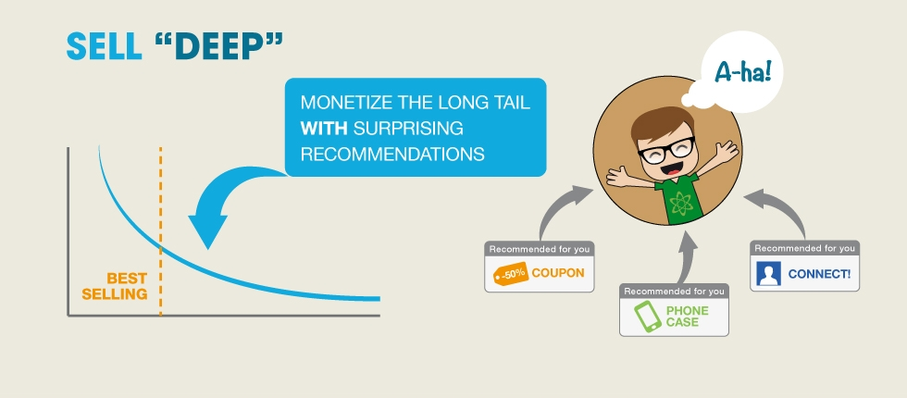
Why Recommender?
“We are leaving the age of information and entering the age of recommendation.”
—— Chris Anderson in “The Long Tail”
Picture from: https://encrypted-tbn1.gstatic.com/images?q=tbn:ANd9GcTON_H3eMI4LSCvtrzSWK8beYhtXs_z70NwAYYA2sQCsjMssEsD

Slide 3
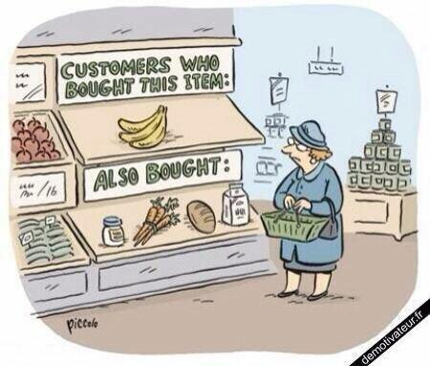
The Age of Recommendation
Search:
User Items
Recommend:
Items User
Picture from: http://insidebigdata.com/wp-content/uploads/2014/06/Humor_recommender.jpg

Slide 4
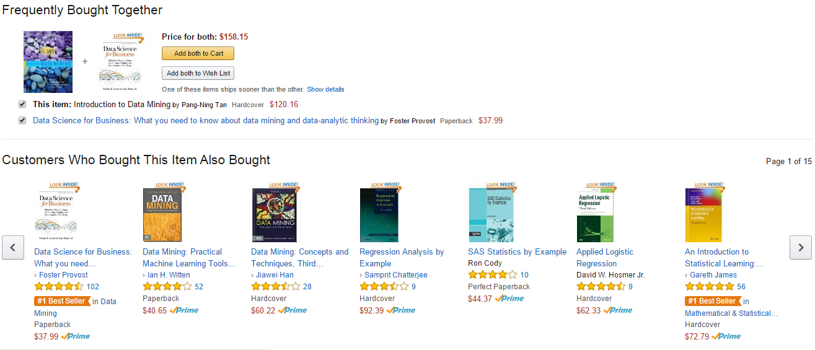
Amazon: A personalized online store
Picture from: amazon.com

Slide 5
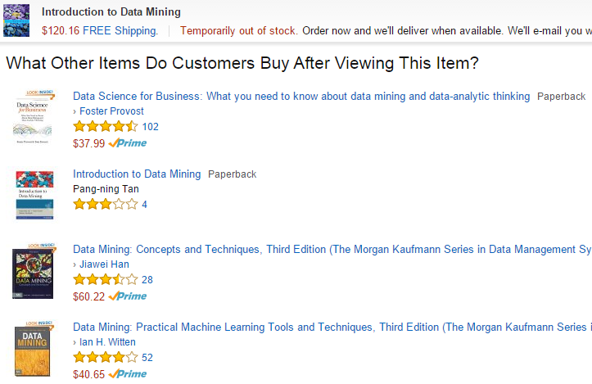
Amazon: A personalized online store
Picture from: amazon.com

Slide 6
Recommender Problem
A good recommender
Show programming titles to a software engineer and baby toys to a new mother.
Don’t recommend items user already knows or would find anyway.
Expand user’s taste without offending or annoying him/her…
Challenges
Huge amounts of data, tens of millions of customers and millions of distinct catalog items.
Results are required to be returned in real time.
New customers have limited information.
Old customers can have a glut of information.
Customer data is volatile.

Slide 7
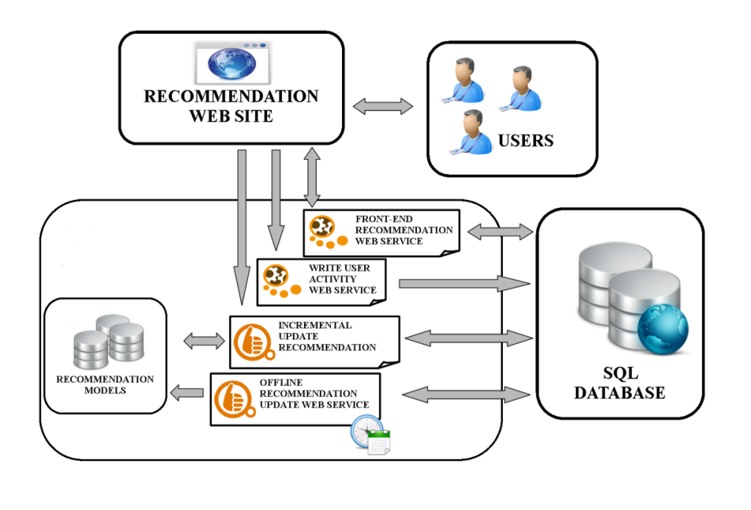
Amazon’s solution
1. Amazon Recommendation Engine
Amazon’s model that implements recommendation algorithm.
Recommendation algorithm is designed to personalize the online store for each customer.
2. Algorithm feature
Most recommendation algorithms start by finding a set of similar customers whose purchased and rated items overlap the user’s purchased and rated items.
The Amazon’s item-to-item collaborative filtering is focusing on finding similar items instead of similar customers.
3. Recommendation Engine Workflow
Picture from: http://elico.rapid-i.com/recommender-extension.html

Slide 8
Personalization
Recommenders are instances of personalization software.
Personalization concerns adapting to the individual needs, interests, and preferences of each user.
Includes:
Recommending
Filtering
Predicting (e.g. form or calendar appt. completion)
From a business perspective, it is viewed as part of Customer Relationship Management (CRM).

Slide 9
Machine Learning and Personalization
Machine Learning can allow learning a user model or profile of a particular user based on:
Sample interaction
Rated examples
This model or profile can then be used to:
Recommend items
Filter information
Predict behavior

Slide 10
Collaborative Filtering
Maintain a database of many users’ ratings of a variety of items.
For a given user, find other similar users whose ratings strongly correlate with the current user.
Recommend items rated highly by these similar users, but not rated by the current user.
Almost all existing commercial recommenders use this approach (e.g. Amazon).

Slide 11
Collaborative Filtering Method
Weight all users with respect to similarity with the active user.
Select a subset of the users (neighbors) to use as predictors.
Normalize ratings and compute a prediction from a weighted combination of the selected neighbors’ ratings.
Present items with highest predicted ratings as recommendations.

Slide 12
Similarity Weighting
Typically use Pearson correlation coefficient between ratings for active user, a, and another user, u.
r_{a} and r_{u} are the ratings vectors for the m items rated by
both a and u
r_{i,j} is user i’s rating for item j

Slide 13
Covariance and Standard Deviation
Covariance:
Standard Deviation:

Slide 14
Significance Weighting
Important not to trust correlations based on very few co-rated items.
Include significance weights, s_{a,u}, based on number of co-rated items, m.

Slide 15
Neighbor Selection
For a given active user, a, select correlated users to serve as source of predictions.
Standard approach is to use the most similar n users, u, based on similarity weights, w_{a,u}
Alternate approach is to include all users whose similarity weight is above a given threshold.

Slide 16
Rating Prediction
Predict a rating, p_{a,i}, for each item i, for active user, a, by using the n selected neighbor users, u ∈ {1,2,…n}.
To account for users different ratings levels, base predictions on differences from a user’s average rating.
Weight users’ ratings contribution by their similarity to the active user.

Slide 17
Problems with Collaborative Filtering
Cold Start: There needs to be enough other users already in the system to find a match.
Sparsity: If there are many items to be recommended, even if there are many users, the user/ratings matrix is sparse, and it is hard to find users that have rated the same items.
First Rater: Cannot recommend an item that has not been previously rated.
New items
Esoteric items
Popularity Bias: Cannot recommend items to someone with unique tastes.
Tends to recommend popular items.

Slide 18
Content-Based Recommending
Recommendations are based on information on the content of items rather than on other users’ opinions.
Uses a machine learning algorithm to induce a profile of the users preferences from examples based on a featural description of content.
Some previous applications:
Newsweeder (Lang, 1995)
Syskill and Webert (Pazzani et al., 1996)

Slide 19
Advantages of Content-Based Approach
No need for data on other users.
No cold-start or sparsity problems.
Able to recommend to users with unique tastes.
Able to recommend new and unpopular items
No first-rater problem.
Can provide explanations of recommended items by listing content-features that caused an item to be recommended.

Slide 20
Disadvantages of Content-Based Method
Requires content that can be encoded as meaningful features.
Users’ tastes must be represented as a learnable function of these content features.
Unable to exploit quality judgments of other users.
Unless these are somehow included in the content features.

Slide 21
Traditional Recommendation Algorithms
Two mostly used traditional algorithms:
User Based Collaborative Filtering
Cluster Models

Slide 22

User Based Collaborative Filtering
Approach
Represents a customer as an N-dimensional vector of items
Vector is positive for purchased or positively rated items and negative for negatively rated items
Based on cosine similarity: finds similar customers/users
Generates recommendations based on a few customers who are most similar to the user
Rank each item according to how many similar customers purchased it
Problems
computationally expensive, O(MN) in the worst case, where
M is the number of customers and
N is the number of items
dimensionality reduction can increase the performance, BUT, also reduce the quality of the recommendation
For very large data sets, such as 10 million customers and 1 million items, the algorithm encounters severe performance and scaling issues

Slide 23
Cluster Models
Approach
Divide the customer base into many segments and treat the task as a classification problem
Assign the user to the segment containing the most similar customers
Uses the purchases and ratings of the customers in the segment to generate recommendations
Cluster models have better online scalability and performance than collaborative filtering because they compare the user to a controlled number of segments rather than the entire customer base.
Problems
Quality of the recommendation is low
The recommendations are less relevant because the similar customers that the cluster models find are not the most similar customers
To improve quality, it needs online segmentation, which is almost as expensive as finding similar customers using collaborative filtering

Slide 24
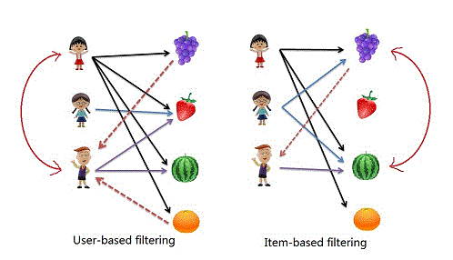
Amazon’s Item-to-Item CF
Difference with User-to-User CF
Picture from: http://paxcel.net/blog/wp-content/uploads/2013/08/recommendation_types.gif

Slide 25
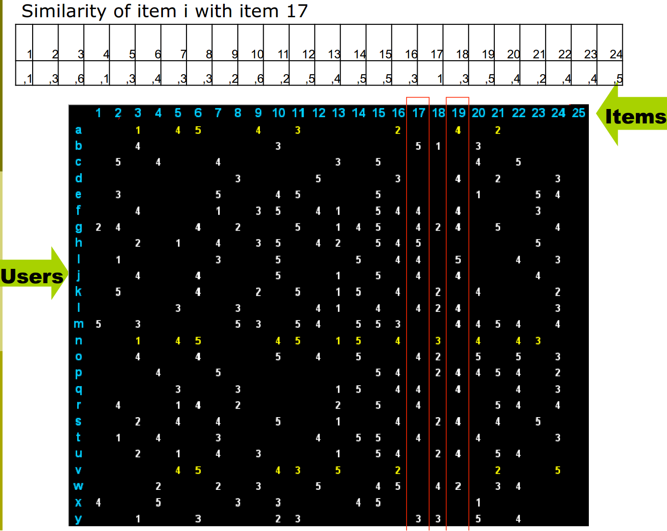
Amazon’s Item-to-Item CF
Picture from: Francesco Ricci, Slides [5]

Slide 26
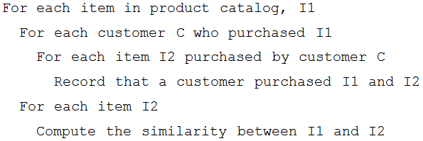
Amazon’s Item-to-Item CF
How It Works
Matches each of the user’s purchased and rated items to similar items
Combines those similar items into a recommendation list
An iterative algorithm:
Builds a similar-items table by finding items that customers tend to purchase together
Provides a better approach by calculating the similarity between a single product and all related products:
The similarity between two items uses the cosine measure
Each vector corresponds to an item rather than a customer and
Vector’s M dimensions correspond to customers who have purchased that item

Slide 27
Offline computation : Online Recommendation
Offline Computation:
builds a similar-items table which is extremely time intensive, O(N²M)
In practice, it’s closer to O(NM), as most customers have very few purchases
Sampling customers can also reduce runtime even further with little reduction in quality.
Online Recommendation:
Given a similar-items table, the algorithm
finds items similar to each of the user’s purchases and ratings,
aggregates those items, and then
recommends the most popular or correlated items.

Slide 28
Scalability and Quality: Comparison
User Based collaborative filtering:
little or no offline computation
impractical on large data sets, unless it uses dimensionality reduction, sampling, or partitioning
dimensionality reduction, sampling, or partitioning reduces recommendation quality
Cluster models:
can perform much of the computation offline,
but recommendation quality is relatively poor
Item-to-Item collaborative filtering:
scalability and performance are achieved by creating the expensive similar-items table offline
online component "looking up similar items“ scales independently of the catalog size or the number of customers
fast for extremely large data sets
recommendation quality is excellent since it recommends highly correlated similar items
unlike traditional collaborative filtering,
the algorithm performs well with limited user data,
producing high-quality recommendations based on as few as two or three items

Slide 29
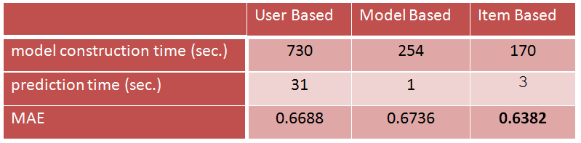
Results:
The MovieLens dataset contains 1 million ratings from 6,040 users on 3,900 movies.
The best overall results are reached by the item-by-item based approach. It needs 170 seconds to construct the model and 3 seconds to predict 100,021 ratings.
Table from: Candillier, L., Meyer, F., & Boull'e Marc. (2007).
Comparing state-of-the-art collaborative filtering systems [3]

Slide 30
Some Related Applications
Pandora
Netflix
Google YouTube

Slide 31

Pandora music recommendation service
How It Works:
Base its recommendation on data from Music Genome Project
Assigns 400 attributes for each song, done by musicians, takes half an hour per song
Use this method to find songs which is similar to user’s favorite songs
Benefits:
Accurate method, don’t need lots of users information, needs little to get started
Drawback:
Doesn't scale very well and often feels that Pandora's library is somewhat limited
Picture from: pandora.com

Slide 32
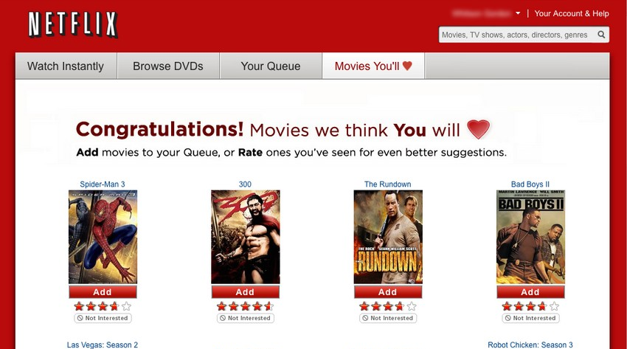
Netflix movie recommendation system
What’s it
Make recommendations by comparing the watching and the searching habits of similar users as well as by offering movies that share characteristics with films that a user has rated highly
Collaborative, content-based, knowledge-based, and demographic techniques serves as the basis of its recommendation system. An ensemble method of 107 different algorithmic approaches, blended into a single prediction
Benefit:
Each of these techniques has known shortcomings, using multiple techniques together achieves some synergy between them.
Picture from: netflix.com

Slide 33

Google YouTube recommendation system
Why:
Focus on videos, bring videos to users which they believe users will be interest in
Increase the numbers of videos, increase the length of time, and maximize the enjoyment
Ultimately google can increase revenue by showing more ads
Interesting things:
Give up its old recommendation system based on random walk, changed to a new one based on Amazon’s item-to-item collaborative filtering in 2010
Amazon’s item-to-item collaborative filtering appears to be the best for video recommendation
Picture from: youtube.com

Slide 34
References:
Linden, G.; Smith, B.; York, J.; , "Amazon.com recommendations: item-to-item collaborative filtering,". Internet Computing, IEEE , vol.7, no.1, pp. 76- 80, Jan/Feb 2003
Takács, G.; Pilászy, I.; Németh, B.; Tikk, D. (March 2009). "Scalable Collaborative Filtering Approaches for Large Recommender Systems". Journal of Machine Learning Research 10: 623-656
Candillier, L., Meyer, F., & Boull'e Marc. (2007). Comparing state-of-the-art collaborative filtering systems. Proceedings of the 5th International Conference on Machine Learning and Data Mining in Pattern Recognition, Leipzig, Germany. 548-562. doi: 10.1007/978-3-540-73499-4_41
Ala Alluhaidan, Ala, "Recommender System Using Collaborative Filtering Algorithm" (2013). Technical Library. Paper 155. http://scholarworks.gvsu.edu/cistechlib/155
Francesco Ricci, Slides on "Item-to-Item Collaborative Filtering and Matrix Factorization". http://www.ics.uci.edu/~welling/teaching/CS77Bwinter12/presentations/course_Ricci/13-Item-to-Item-Matrix-CF.pdf
Xavier Amatriain, Bamshad Mobasher; KDD 2014 Tutorial - the recommender problem revisited. http://www.kdd.org/kdd2014/tutorials.html

Slide 35
THANK YOU

